Slide 1
World War I
1914 - 1918
BELL RINGER:
On a sheet of paper, create a KWL Chart on WWI. (What do I Know? What do I Want to Know? What have I Learned?) See example below for guidance.
KNOW: I know the war was fought in Europe I know the side America fought on won the war | WANT: I want to know if Hitler fought in this war I want to know why WWI started What did women do during WWI? | LEARN: You will fill this column as the unit progresses. At this time, do not put anything here since we have not had a lesson on WWI yet.

Slide 2
World War I
1914 - 1918

Slide 3
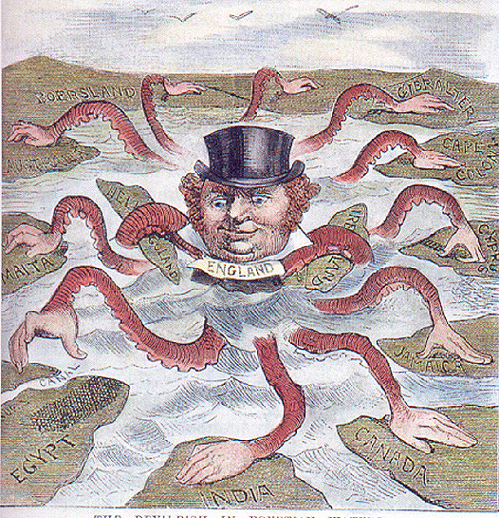
Causes
Imperialism – super powers would establish colonies in other nations or territories

Slide 4
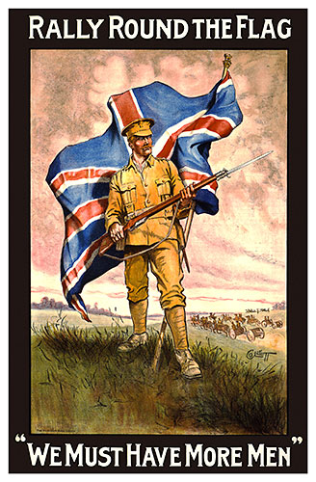
Causes
Nationalism – pride in one’s own people & country
Notes:
Slide for each cause- maps, pics

Slide 7
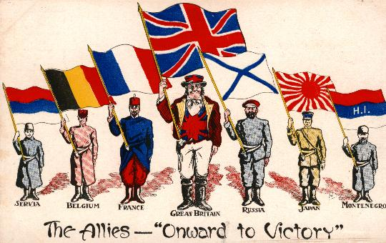
Causes
Alliances – nations signed treaties w/ each other saying they would fight for each other in the event of war

Slide 8
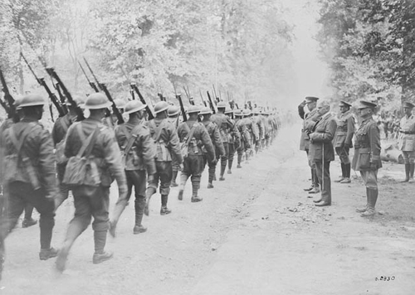
Causes
Militarism – European nations had large armies, navies, & supplies of weapons

Slide 9
Understanding the Causes of WWI

Slide 10
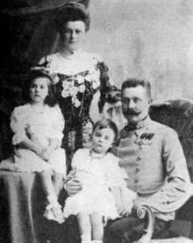
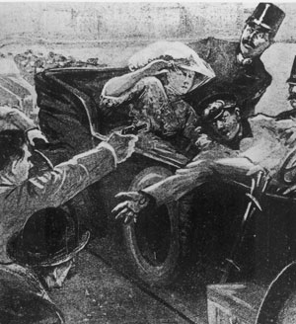
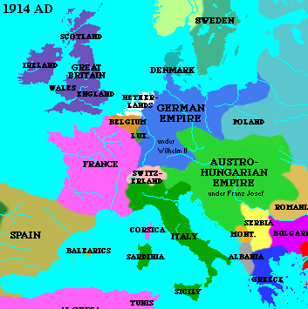
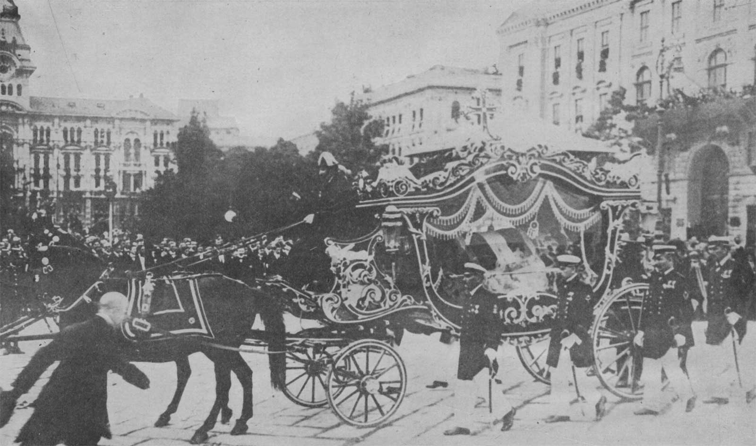
Archduke Franz Ferdinand
Ferdinand was to
be next emperor
of Austria-Hungary

Slide 11
Assassination
June 28, 1914
Archduke Francis Ferdinand & wife (A-H) killed by Serbian who was angry A-H was ruling his country
Austria-Hungary blamed Serbia & declared war
Great Britain, France, & Russia had alliance with Serbia

Slide 13
Allied Powers
Great Britain
France
Russia
Serbia
Italy (1915)
USA (1917)
Notes:
Try to get different map

Slide 14
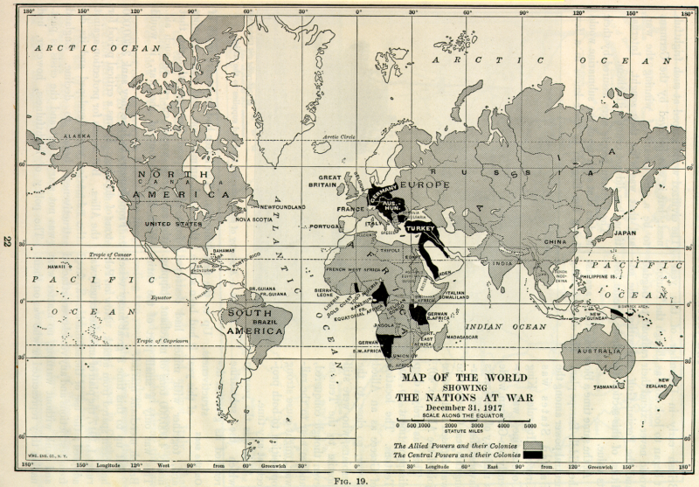
Central Powers
Austria-Hungary
Germany
Turkey
Ottoman Empire
Bulgaria

Slide 15
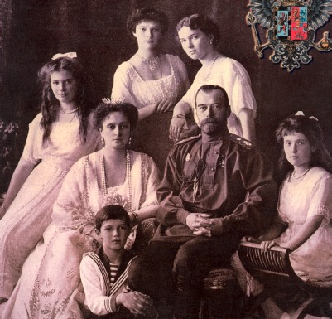
Russian Revolution
Germans defeating Russians
Czar Nicholas II wouldn’t surrender
Two million Russians killed
March 1917 – Russians revolted
Forced Nicholas to resign
New government continued to
fight WW I

Slide 16
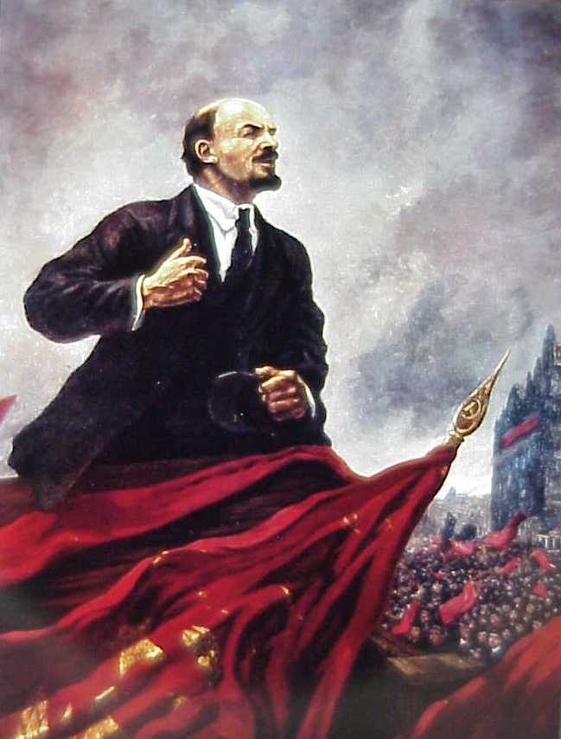
Russian Revolution (continued)
November 1917 – Russian Revolution
Communist won control
Government owns businesses
Vladimir Lenin – leader
1918 – Lenin signed peace treaty with Germany to end fighting – freed Germany to concentrate on fighting in West (France)

Slide 17
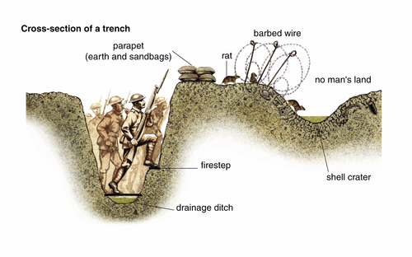
Trench Warfare
Long ditches dug in earth
Often separated by barbed wire
Soldiers fired machine guns & poison gas

Slide 18
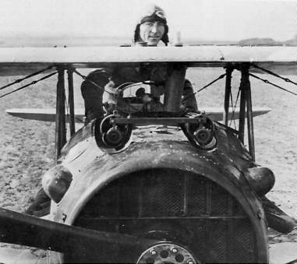
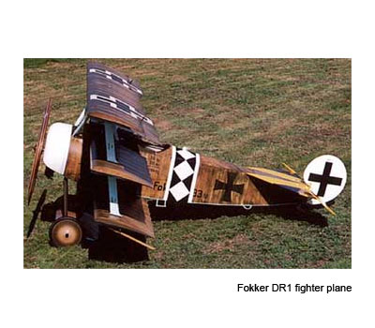
New Technology
Airplanes

Slide 19
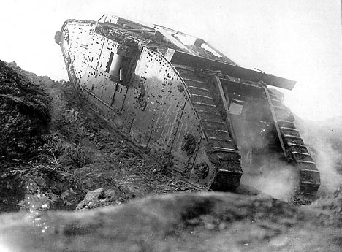
New Technology
Tanks

Slide 20
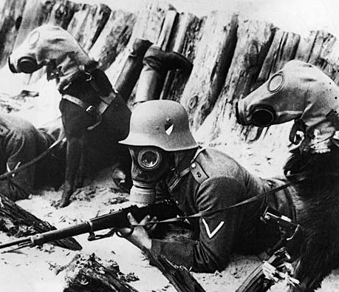
New Technology
Poison Gas

Slide 21
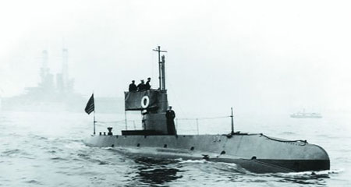
New Technology
Submarines

Slide 22
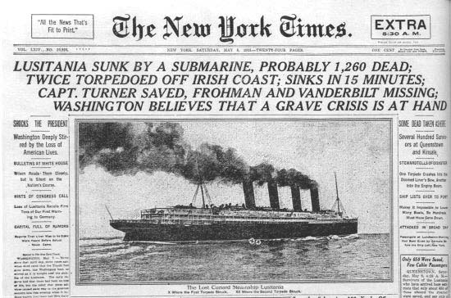
Lusitania
British merchant ship carrying 1,200 passengers (128 Americans)
1915 – Sunk by Germans

Slide 23
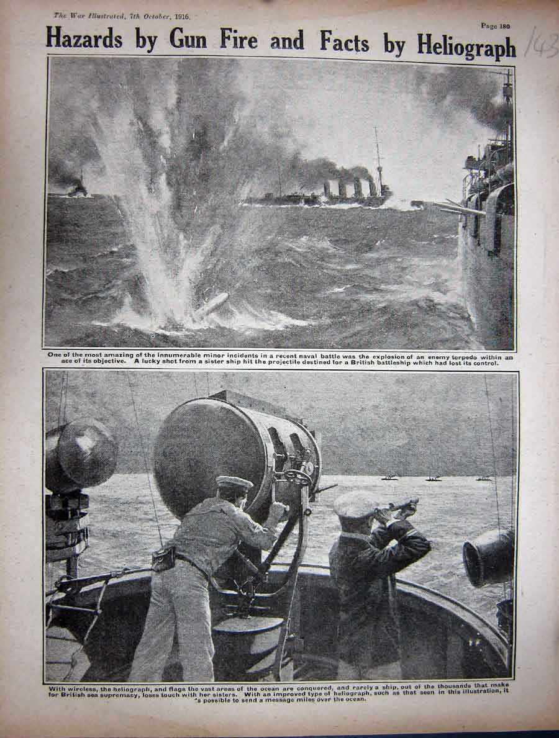
German Submarines / U-Boats
Sank several USA ships
USA declared war – April 6, 1917

Slide 24
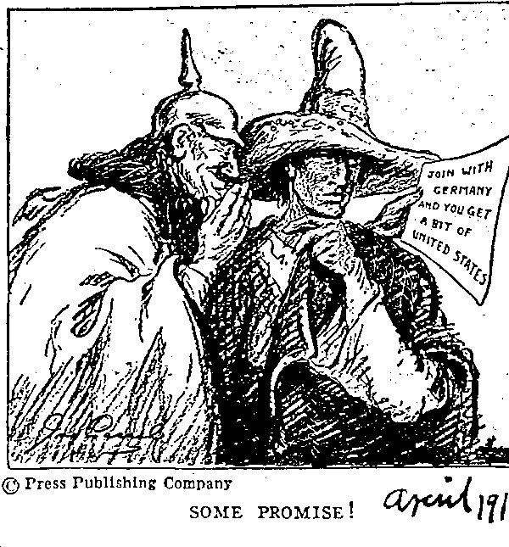
Zimmerman Note
1917 – Germany asked Mexico to go to war against USA
Germany promised Mexico lands lost to USA in 1848

Slide 25
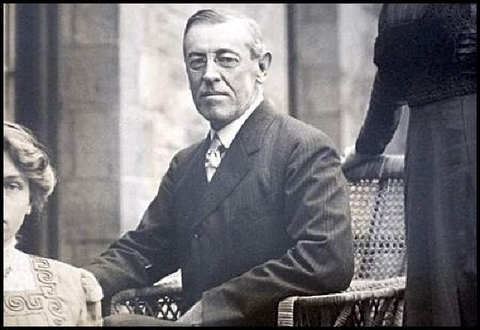
USA Involvement
USA tried to remain neutral
President Woodrow Wilson
Americans mixed on sides to support

Slide 26
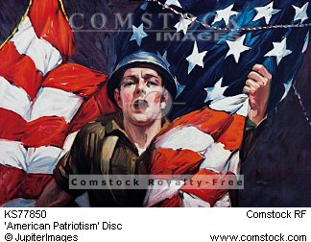
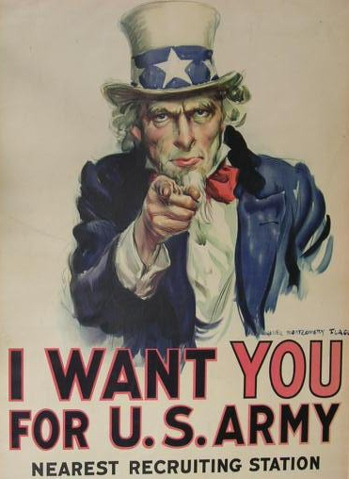
Life in USA – WW I (continued)
Propaganda
Encouraged men to become soldiers
Encouraged people to buy Liberty Bonds

Slide 27
US Involvement

Slide 28
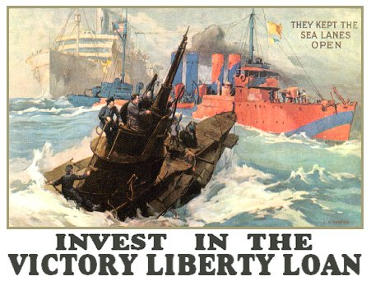
Life in USA during WW I
Government must raise money to pay for war
Raise taxes
Liberty Bonds

Slide 29
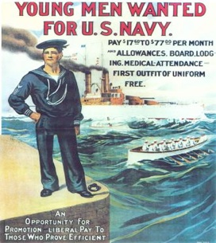
Life in USA during WW I
Raise army
Selective Service Act
All men 18 to 45 register for draft

Slide 30
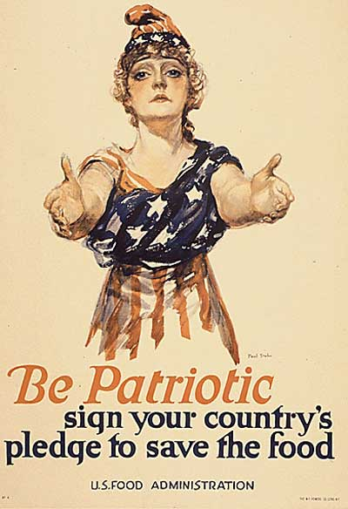
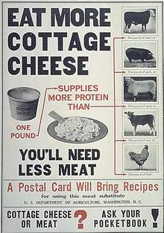
Life in USA – WW I (continued)
Grow Victory Gardens
Paid farmers to grow more
food
Helped feed Allied Powers
Rationing: No meat or wheat on
certain days

Slide 31
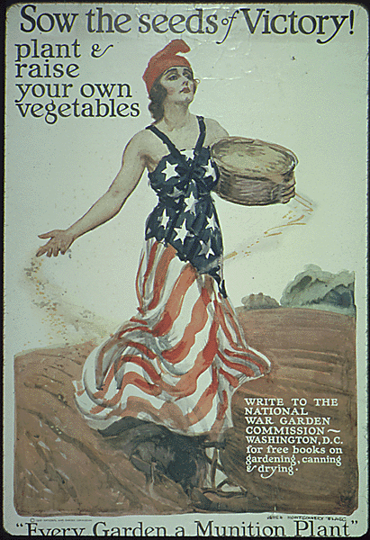

Slide 32
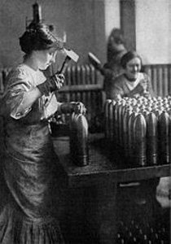
Women in the Workplace
Women replace fighting men at work jobs

Slide 33
Treaty of Versailles
President Woodrow Wilson’s Plan
“Fourteen Points”: Called for nations to be able to choose what type of government that would be set up
Called for League of Nations: assembly of nations to continue world peace and discuss global issues
Treaty by Allied Nations
Treaty of Versailles – November 11, 1918
Blamed Germany for war & forced them to pay billions of $
Wilson signed but Senate refused to ratify

Slide 34
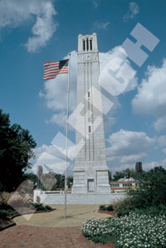
Results of World War I
Created new map of Europe & Middle East
Caused terrible damage & loss of life
USA lost 126,000
10 million deaths worldwide for WW I
Planted seeds of anger in Germany – WW II
NCSU Bell Tower
In memory of alumni
killed in World War I

Slide 35
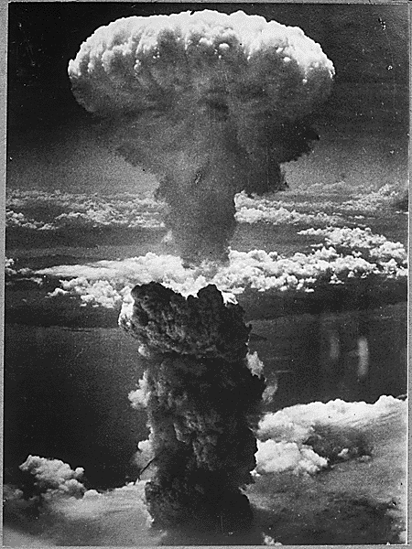
Legacy of WWI
Although the US wanted to remain neutral in world affairs, we ended up entering into WWI. This left a lasting legacy of being involved with other nations.
There was no true agreement on post-war peace treaties which eventually led to the start of the WWII.

Slide 36
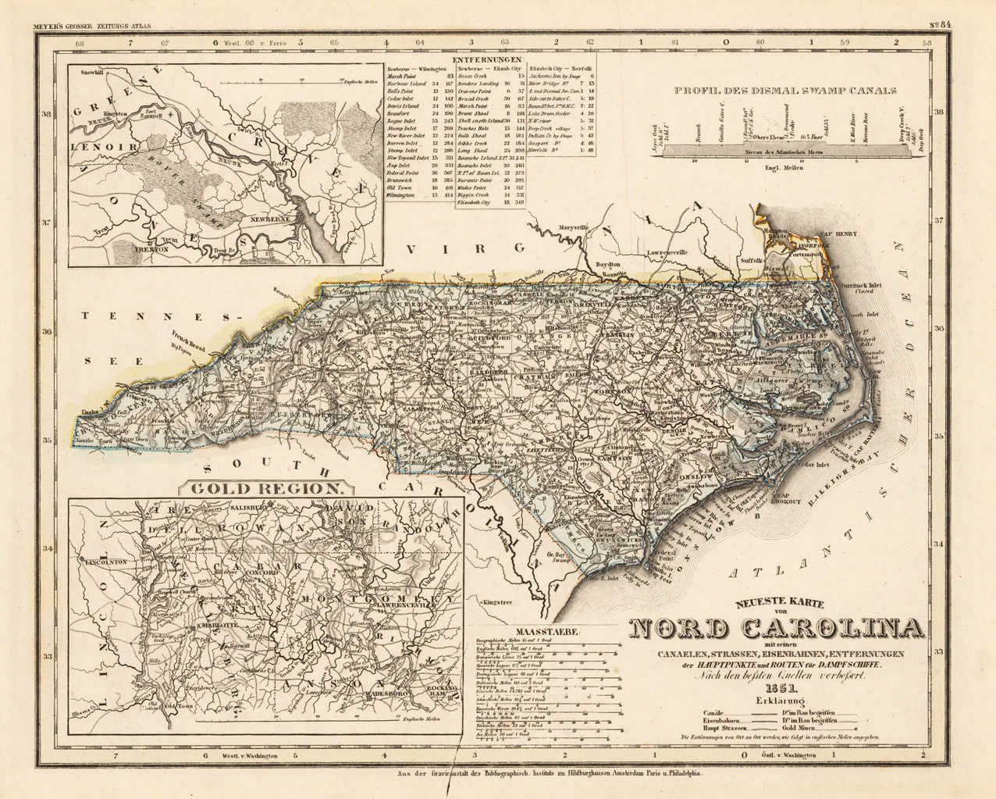
North Carolina in WWI
During WWI….the economy thrived!
Why? Think about the industries of NC. What could they provide for the war?

Slide 37
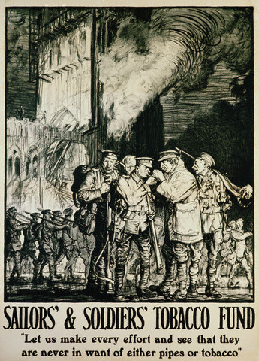
North Carolina in WWI
The tobacco industry thrived! Soldiers smoked a lot of cigarettes to deal with the stresses of war.
30 railroad cars full of tobacco would be shipped across seas for soldiers!

Slide 38
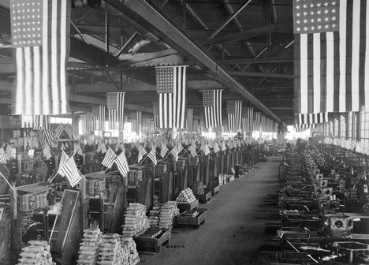
North Carolina in WWI
The Raleigh Iron Works Factory produced shell casings for bullets used by French, British and American troops

Slide 39
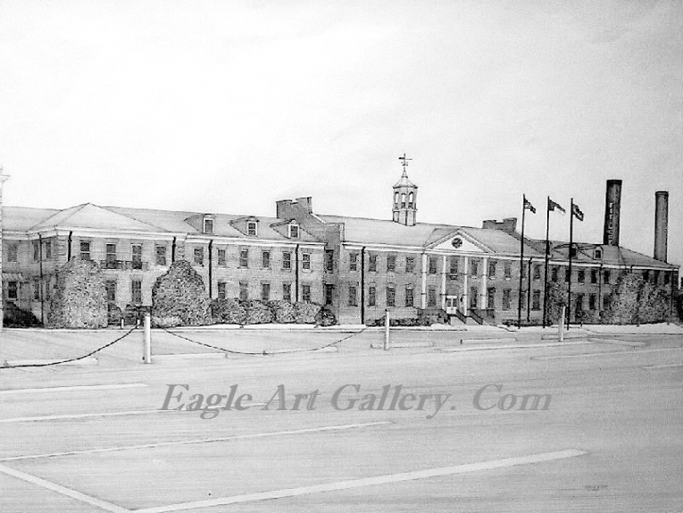
North Carolina in WWI
Cannon Mills Factory in Kannapolis provided towels & linens for soldiers during the war.

Slide 40
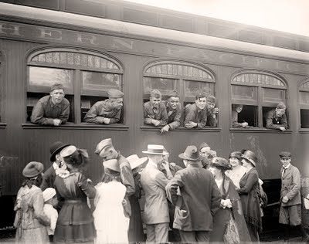
North Carolina after WWI
Troops came back from the war and wanted their jobs back!

Slide 41
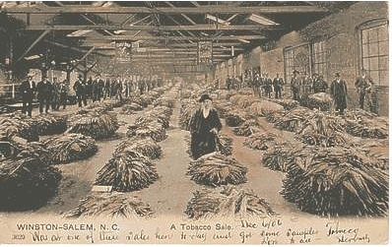
North Carolina after WWI
Factories did not need to produce as many goods because they did not need to supply the armies any longer. This meant farmers did not have to produce as much tobacco & cotton, prices dropped and so did the number of jobs needed in the factories.
Overall, the economy of NC slumped after WWI.

